Slide 1


Jia Shen Ang
12 June 2022

Slide 2

Outline
Executive Summary
Introduction
Methodology
Results
Conclusion
Appendix

Slide 3
Executive Summary
Summary of methodologies
Summary of all results

Slide 4
Introduction
Project background and context
Problems you want to find answers

Slide 5

Section 1

Slide 6
Methodology
Executive Summary
Data collection methodology:
Describe how data was collected
Perform data wrangling
Describe how data was processed
Perform exploratory data analysis (EDA) using visualization and SQL
Perform interactive visual analytics using Folium and Plotly Dash
Perform predictive analysis using classification models
How to build, tune, evaluate classification models

Slide 7
Data Collection
Describe how data sets were collected.
You need to present your data collection process use key phrases and flowcharts

Slide 8
Data Collection – SpaceX API
Data was collected by sending a get request to the SpaceX API
The API responded to the get request in a JSON format
The data was parsed into a Pandas Data Frame
The data frame was then cleaned up
Filtering only Falcon 9 rockets
Dealing with missing values
Data then exported to CSV
Github URL:
https://github.com/jiashenang/IBM-AppliedDataScienceCapstone/blob/master/1-1%20-%20Data%20Collection%20API.ipynb
Python
https://api.spacexdata.com/
Get request
Parse and clean up response
Response

Slide 9
Data Collection - Scraping
Data was scraped from tables on Wikipedia
Scraping was made possible with the following libraries
Request
Beautiful soup
Pandas
Github URL: https://github.com/jiashenang/IBM-AppliedDataScienceCapstone/blob/master/1-2%20-%20Data%20Collection%20with%20Web%20Scraping.ipynb
HTTP Get Request to Wikipedia
Parse response with Beautiful Soup
Identify tables with required data
Export Results to CSV
Convert data into Pandas Data Frame
Extract data from relevant table

Slide 10
Data Wrangling
Describe how data were processed
You need to present your data wrangling process using key phrases and flowcharts
Add the GitHub URL of your completed data wrangling related notebooks, as an external reference and peer-review purpose

Slide 11
EDA with Data Visualization
Summarize what charts were plotted and why you used those charts
Add the GitHub URL of your completed EDA with data visualization notebook, as an external reference and peer-review purpose

Slide 12
EDA with SQL
Using bullet point format, summarize the SQL queries you performed
Add the GitHub URL of your completed EDA with SQL notebook, as an external reference and peer-review purpose

Slide 13
Build an Interactive Map with Folium
Summarize what map objects such as markers, circles, lines, etc. you created and added to a folium map
Explain why you added those objects
Add the GitHub URL of your completed interactive map with Folium map, as an external reference and peer-review purpose

Slide 14
Build a Dashboard with Plotly Dash
Summarize what plots/graphs and interactions you have added to a dashboard
Explain why you added those plots and interactions
Add the GitHub URL of your completed Plotly Dash lab, as an external reference and peer-review purpose

Slide 15
Predictive Analysis (Classification)
Summarize how you built, evaluated, improved, and found the best performing classification model
You need present your model development process using key phrases and flowchart
Add the GitHub URL of your completed predictive analysis lab, as an external reference and peer-review purpose

Slide 16
Results
Exploratory data analysis results
Interactive analytics demo in screenshots
Predictive analysis results

Slide 17

Section 2

Slide 18
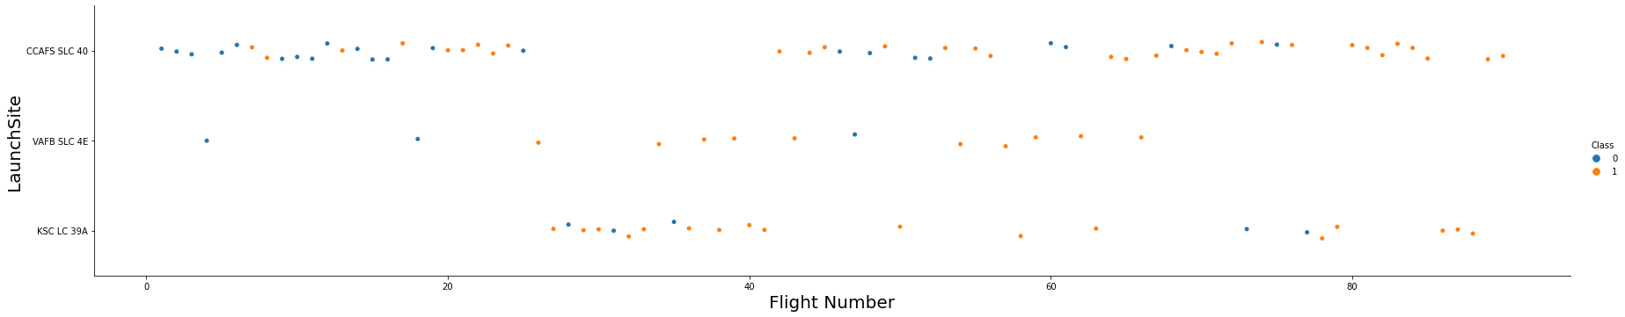
Flight Number vs. Launch Site
Earlier launches took place from CCAFS SLC, and many of those ended in failure to land.
At around 20 flights, the success rate of missions went up dramatically
Of the three sites, VAFB SLC which is on the west coast is used the least.
Large gap in launches around flight 29 from CCAFS SLC caused by a launch pad explosion of a Falcon 9 rocket during testing.

Slide 19
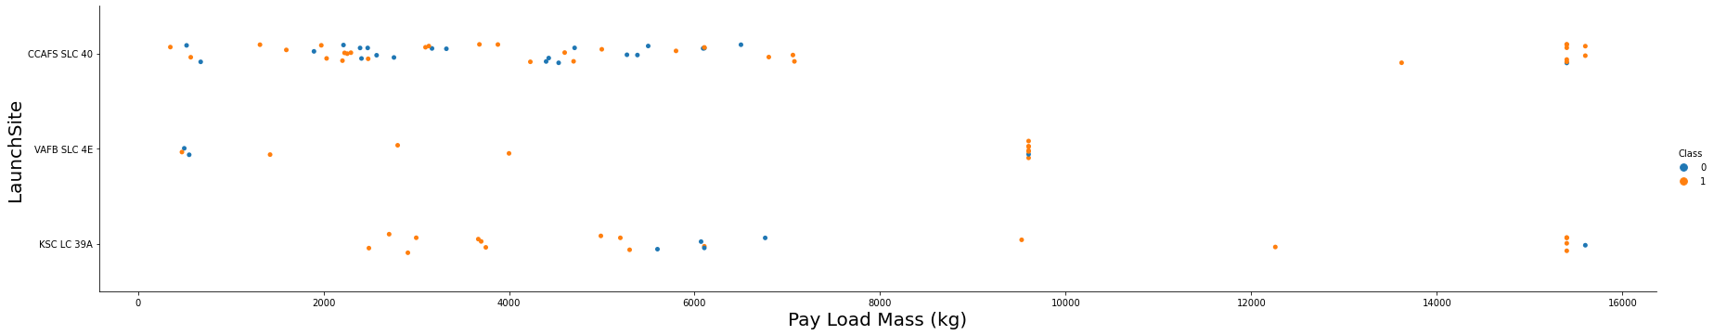
Payload vs. Launch Site
VAFB-SLC has no payloads with mass greater than 10,000 kg.
Majority of launch have a payload mass of under 8,000 kg.

Slide 20
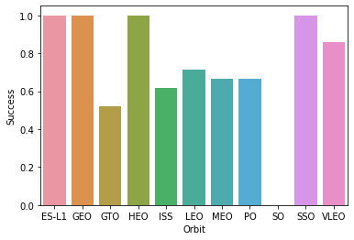
Success Rate vs. Orbit Type
ES-L1, GRO, HEO, SSO orbit types have the highest success rate. Succeeding 100% of the time.
While GTO has the lowest success rate.

Slide 21
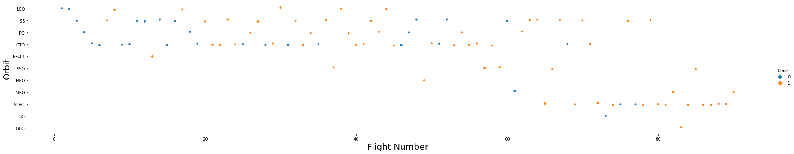
Flight Number vs. Orbit Type
Earlier flights focused on sending payload to LEO, ISS, PO, and GTO orbits.
Later flights started to send payload to VLEO – many of those are Starlink launches.

Slide 22
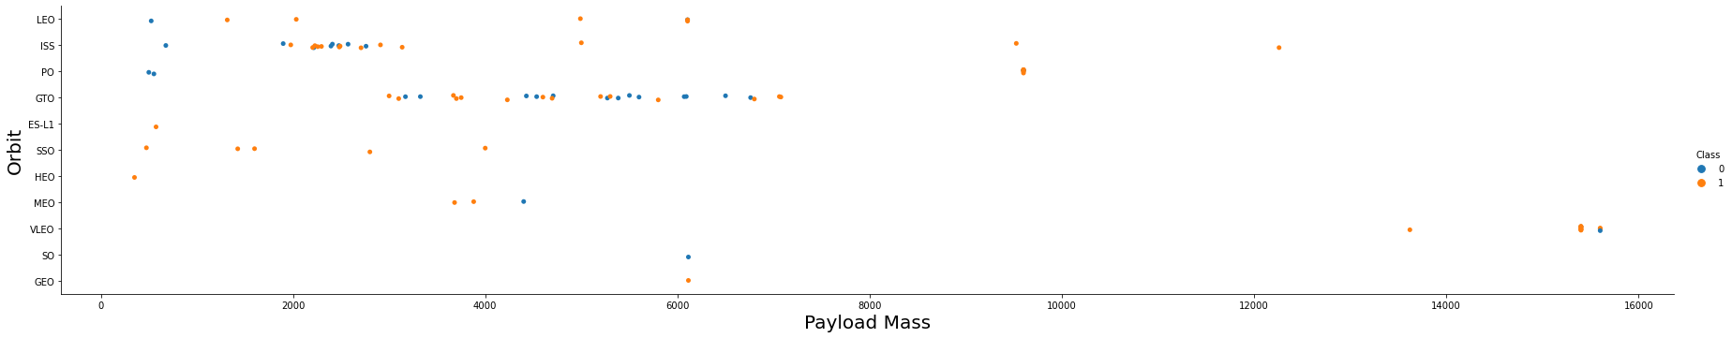
Payload vs. Orbit Type
Certain orbits have certain payload ranges
When launching to VLEO the Falcon 9 can carry close to 16,000 kg
When flying to the ISS, a typical launch would carry payload in 2,000 – 3,000 kg
While to GTO the payload range of 3,000 – 7,000 kg

Slide 23
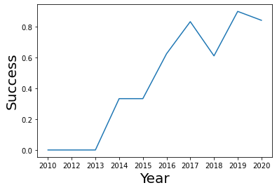
Launch Success Yearly Trend
SpaceX has made dramatic improvements to successfully landing their boosters.

Slide 24
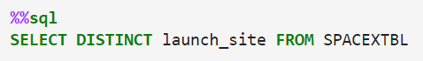
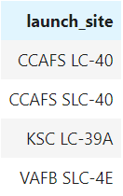
All Launch Site Names

Slide 25
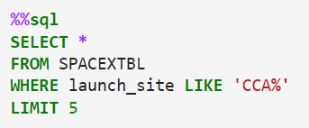
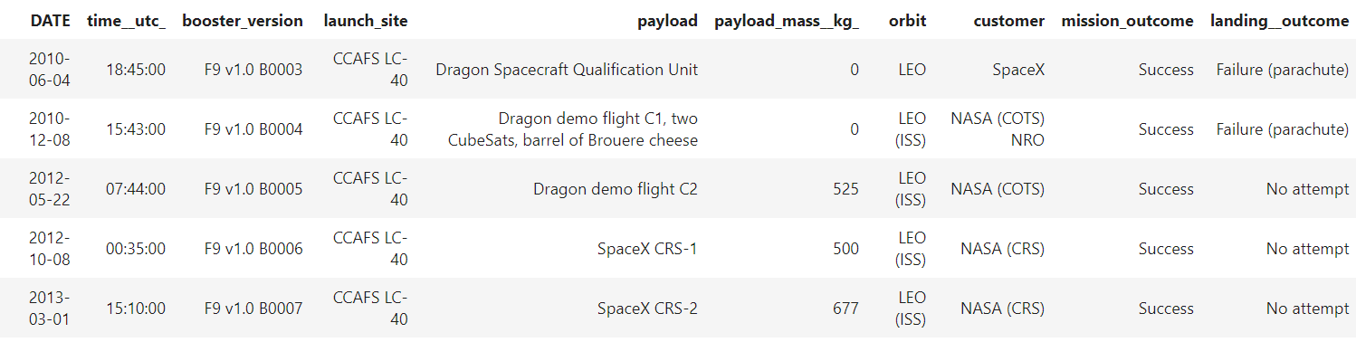
Launch Site Names Begin with 'CCA'

Slide 26
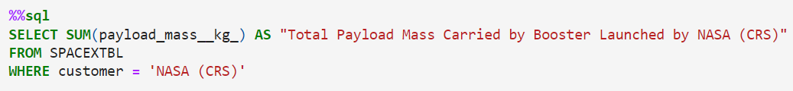
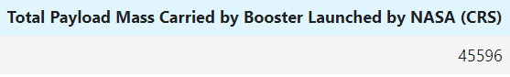
Total Payload Mass

Slide 27
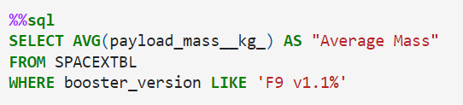
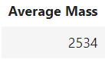
Average Payload Mass by F9 v1.1

Slide 28
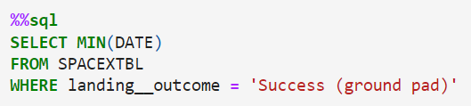
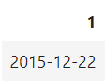
First Successful Ground Landing Date

Slide 29
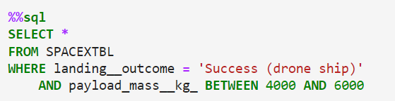
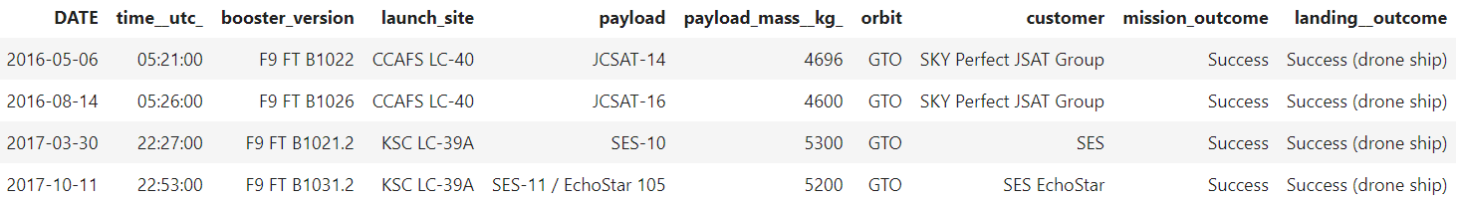
Successful Drone Ship Landing with Payload between 4000 and 6000

Slide 30
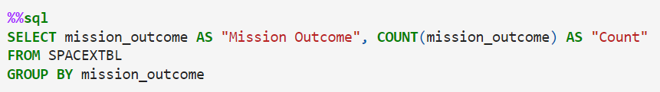
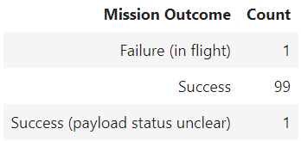
Total Number of Successful and Failure Mission Outcomes

Slide 31
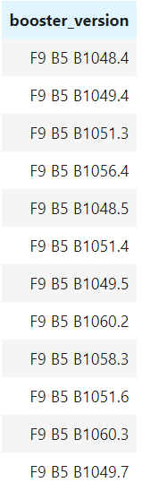
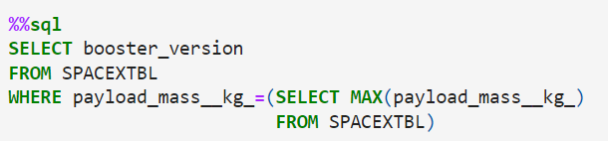
Boosters Carried Maximum Payload

Slide 32
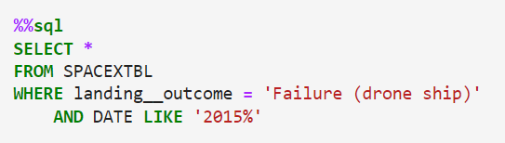
2015 Launch Records

Slide 33
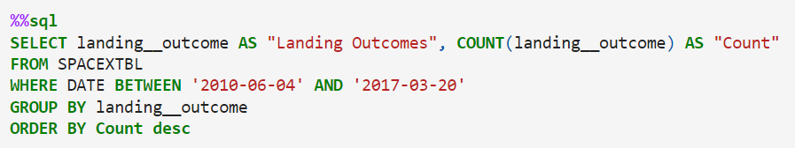
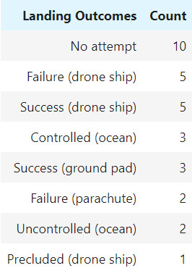
Rank Landing Outcomes Between 2010-06-04 and 2017-03-20

Slide 34

Section 3

Slide 35
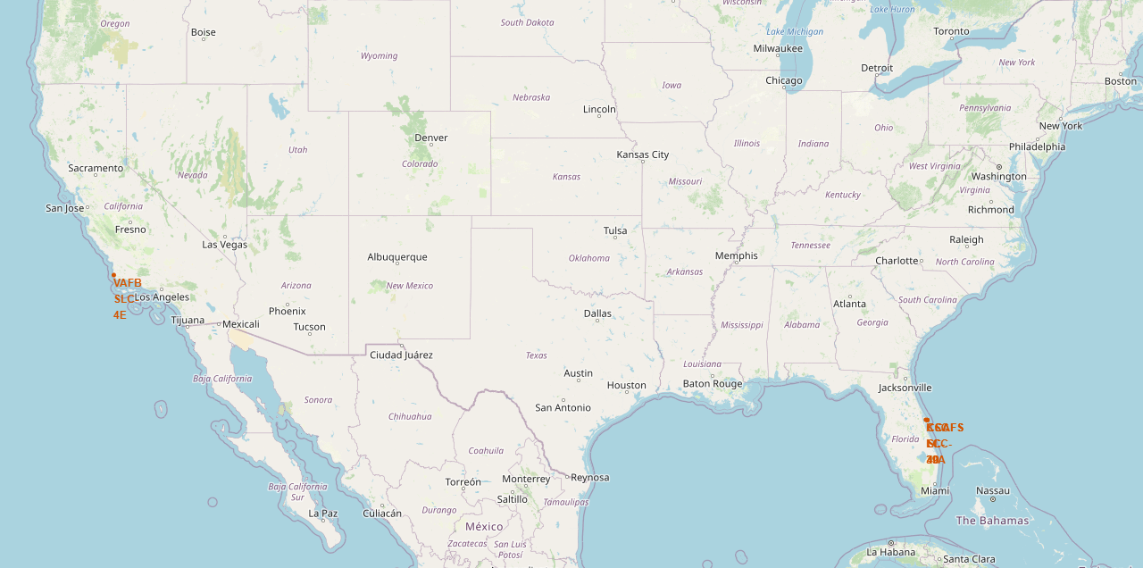
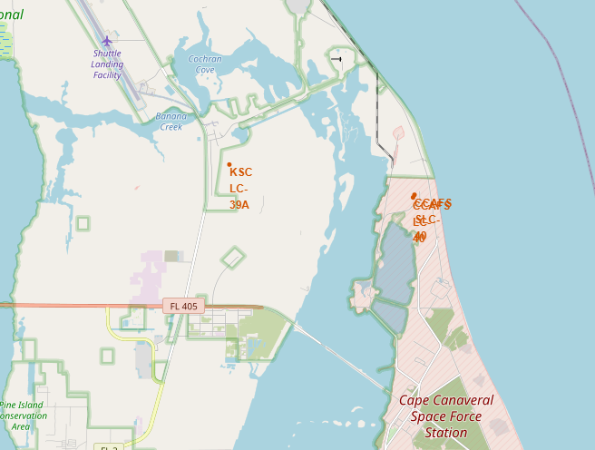
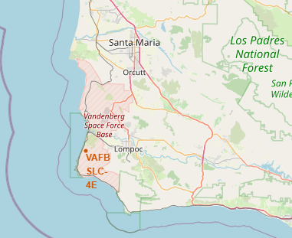
Locations of SpaceX Launch Sites
East Coast:
- Vandenberg Space Launch Complex 4
West Coast:
- Kennedy Space Center Launch Complex 39A
- Cape Canaveral Space Launch Complex 40
SpaceX has two launch sites in the US.
They are located next to the ocean so they can launch out to and land out in the sea
Sites on the east and west coasts
Sites as close to the equator in the US to take advantage of the earth’s spin.

Slide 36
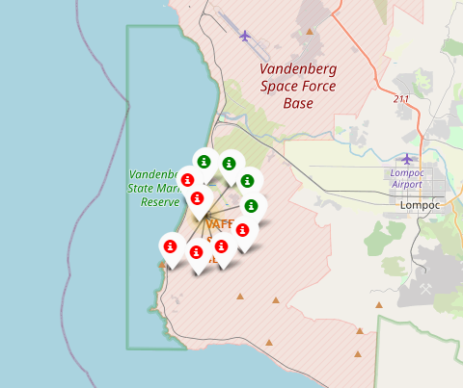
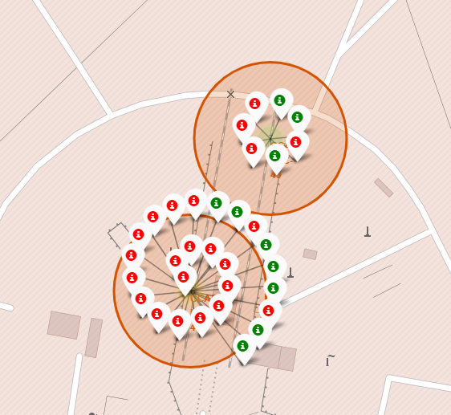
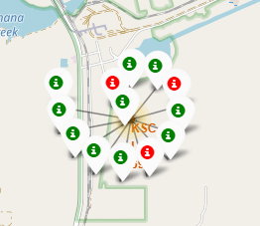
Launch outcomes from each site visualized
Vandenberg Space Launch Complex 4
- Cape Canaveral Space Launch Complex 40
Kennedy Space Center Launch Complex 39A

Slide 37
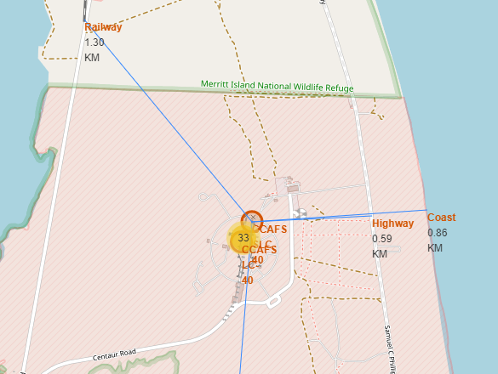
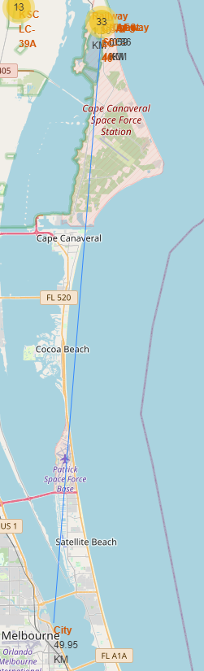
Proximity of the CCAFS SLC-40 launch site to key sites
Site | Distance / KM
Railway | 1.3
Highway | 0.59
Coast | 0.86
City | 49.95

Slide 38

Section 4

Slide 39
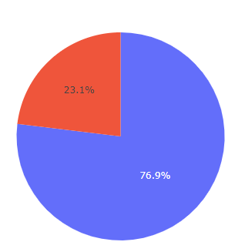
Total Success and Failures for SpaceX Launches
SpaceX are successfully launching their payloads over 75% of the time
Red: Failure
Blue: Success

Slide 40
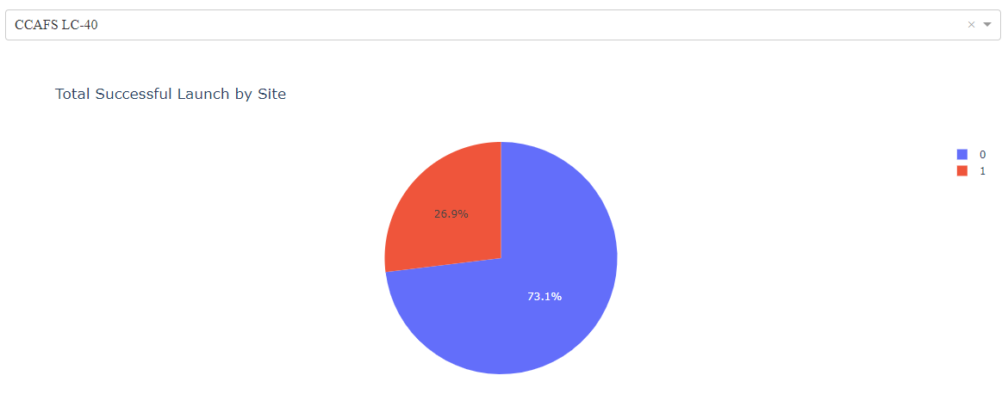
CCAFS LC-40 has launched the most successful number of missions
Red: Failure
Blue: Success

Slide 41
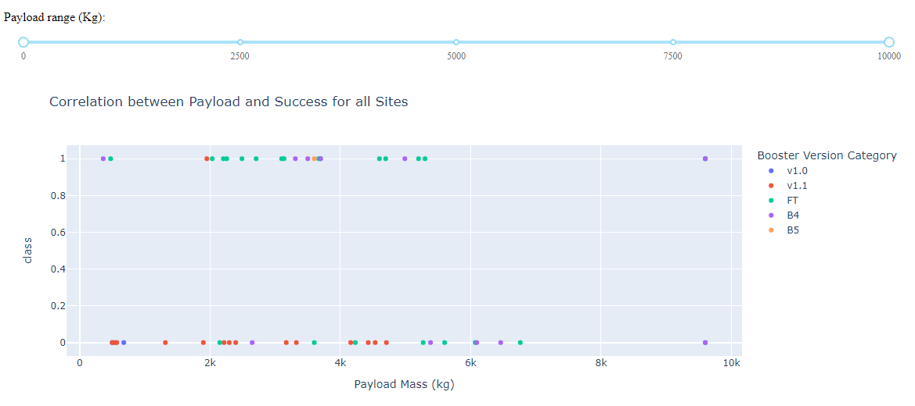
Payload vs. Launch Outcome
FT has a much higher success rate.
V1.1 had a very high failure rate

Slide 42

Section 5

Slide 43
Classification Accuracy
Visualize the built model accuracy for all built classification models, in a bar chart
Find which model has the highest classification accuracy

Slide 44
Confusion Matrix
Show the confusion matrix of the best performing model with an explanation

Slide 45
Conclusions
Point 1
Point 2
Point 3
Point 4
…

Slide 46
Appendix
Include any relevant assets like Python code snippets, SQL queries, charts, Notebook outputs, or data sets that you may have created during this project

Slide 47


